Slide 2
Best Practices for Accelerated Image Distribution Using Dragonfly
Wenbo Qi – Ant Group
Yiyang Huang - ByteDance

Slide 3

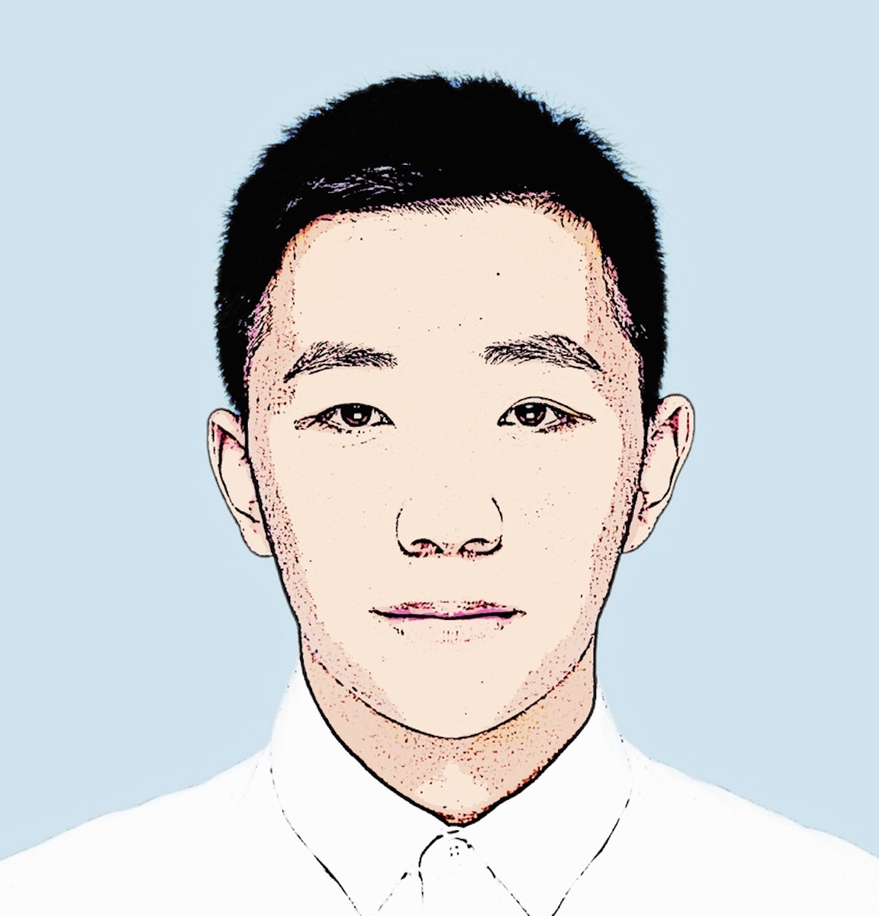
Speakers
Wenbo Qi Software Engineer, Ant Group
Yiyang Huang Software Engineer, ByteDance

Slide 4
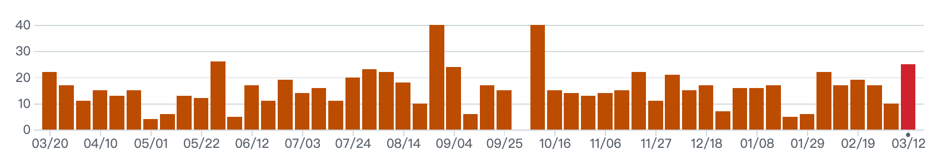
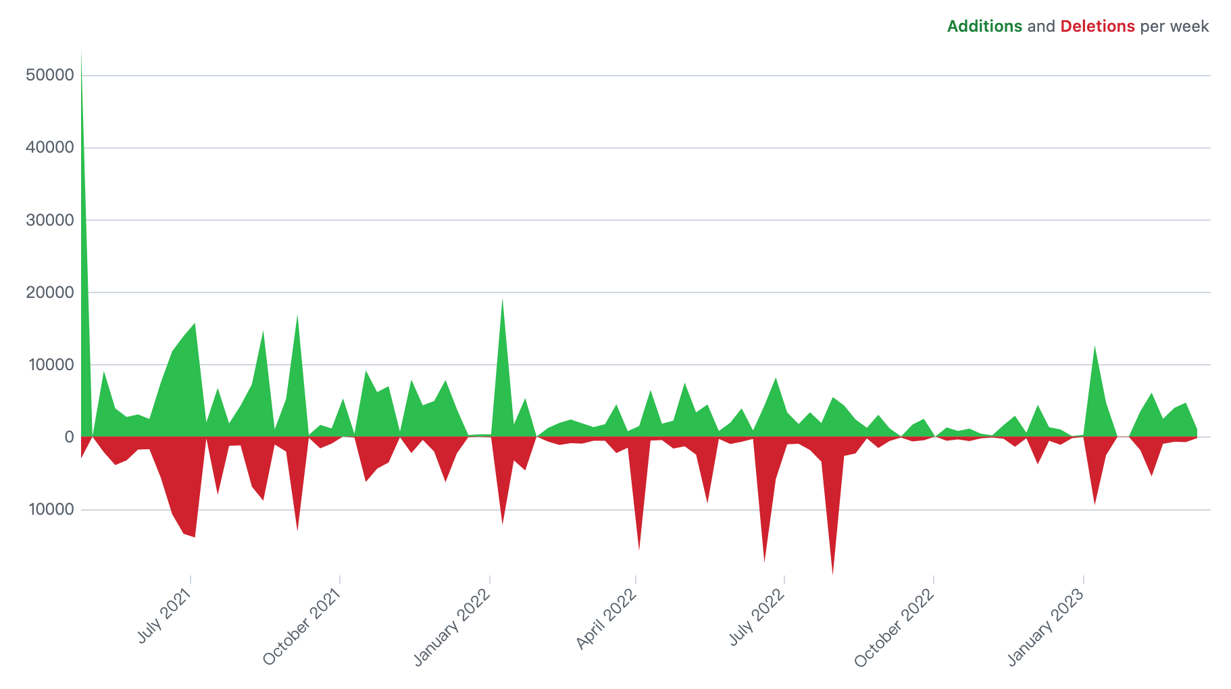
Introduction
Introduction:
Dragonfly is an open source P2P-based file distribution and image acceleration system. It is hosted by the Cloud Native Computing Foundation(CNCF) as an Incubating Level Project.
Milestone:
1. Dragonfly was accepted to CNCF on 11/15/2018 and it is a CNCF Incubating project.
2. Dragonfly 1.X has been upgraded to 2.0 on 9/9/2021.
3. Dragonfly has released 170+ releases on 16/3/2023.
Maintainers:
From Ant Group, Alibaba, ByteDance, Baidu Group, GitLab, etc.
Discussion Group:
Slack Channel: #dragonfly on CNCF Slack
Twitter: dragonfly_oss
Discussion Group: dragonfly-discuss@googlegroups.com
Developer Group: dragonfly-developers@googlegroups.com

Slide 5
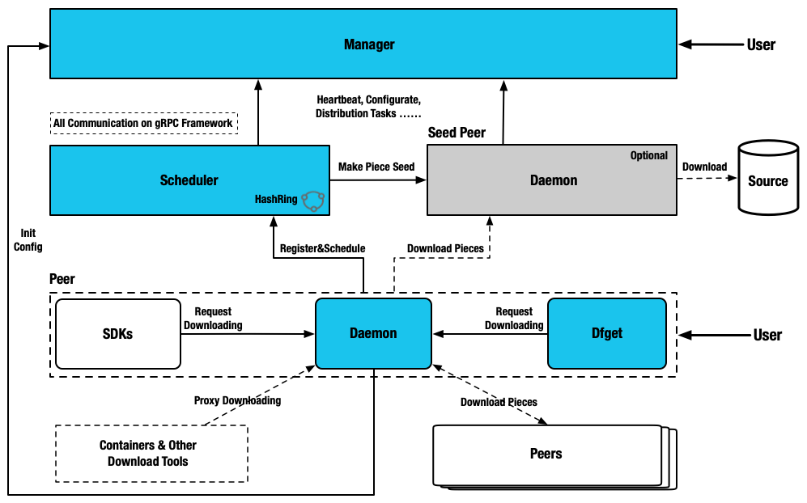
Architecture
Manager:
Maintain the relationship between each P2P cluster, dynamic configuration management and RBAC. It also includes a front-end console, which is convenient for users to visually operate the cluster.
Scheduler:
Select the optimal download parent peer for the download peer. Exceptions control peer back-to-source.
Seed Peer:
Dfdaemon turns on the Seed Peer mode can be used as a back-to-source download peer in a P2P cluster, which is the root peer for download in the entire cluster.
Peer:
Deploy with dfdaemon, based on the C/S architecture, it provides the dfget command download tool, and the dfget daemon running daemon to provide task download capabilities.

Slide 6
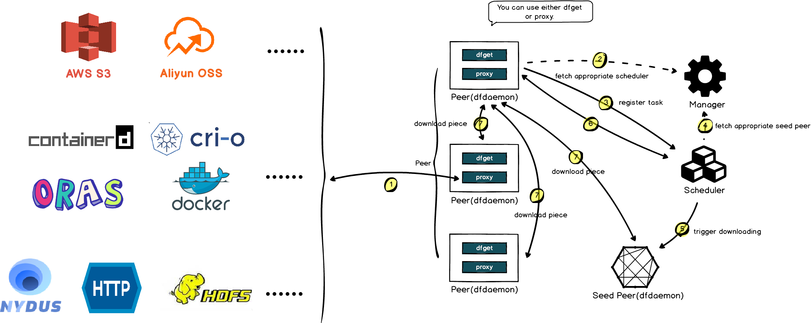
File Distribution & Image Acceleration

Slide 7
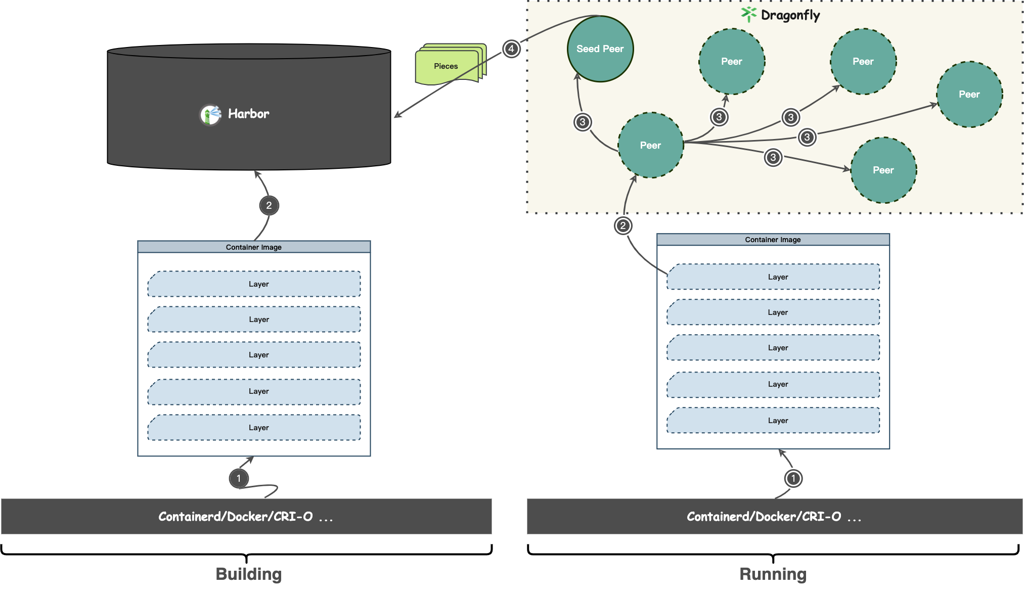
Acceleration Framework For Image

Slide 8

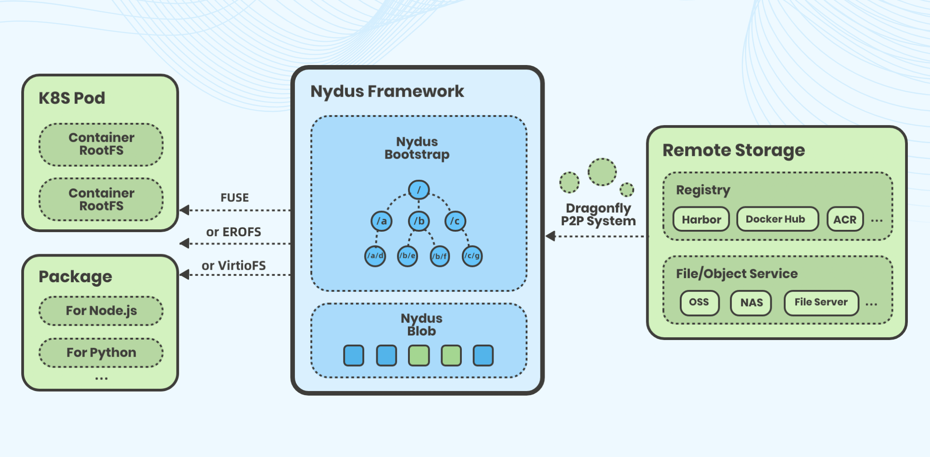
Dragonfly Nydus
Introduction:
Nydus Acceleration Framework implements a content-addressable filesystem that can accelerate container image startup by lazy loading. It has supported the creation of millions of accelerated image containers daily. Currently, it primarily maintained by Ant Group, Alibaba Cloud, and ByteDance etc.
Features:
- Image can be fetched on demand in chunks for lazy pulling to boost container startup.
- Deeply integrated with the Linux kernel's erofs and fscache, enabling in-kernel support for image acceleration.
- From build-time to run-time, nydus covers container ecosystems such as docker, containerd, podman, buildkit, nerdctl.
- Faster build speed than OCI v1 gzip/zstd format, as well as the ability to directly accelerate OCI v1 image.
- The ability to deduplicate data at the chunk level between local and server-side (registry) reduces storage waste of over 50%+ caused by incremental builds.

Slide 9
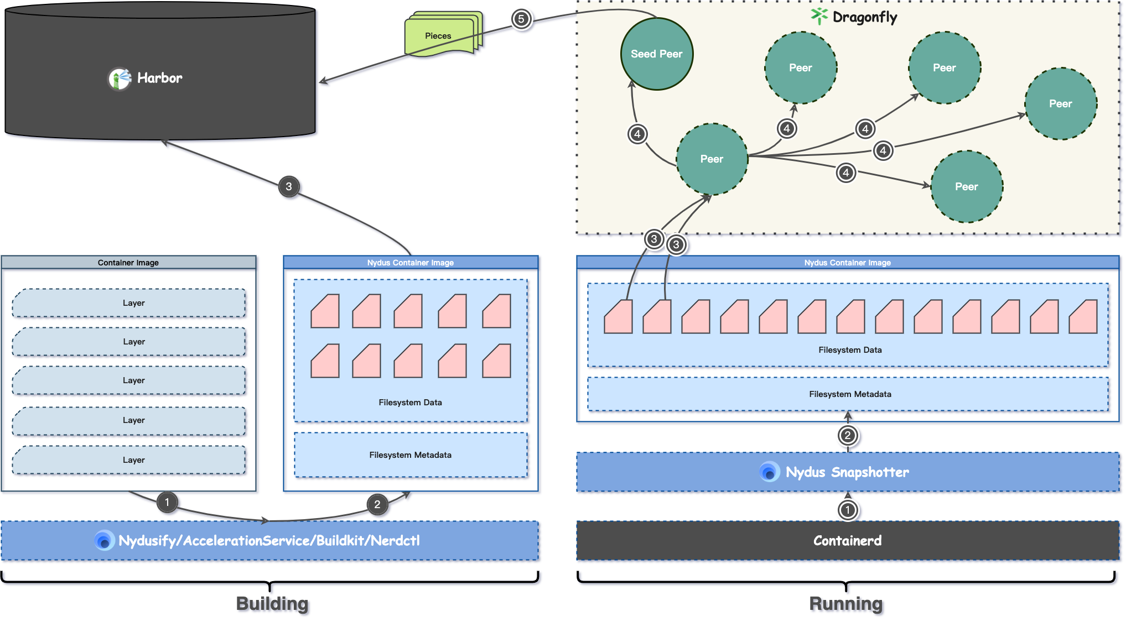
Acceleration Framework For Image

Slide 10
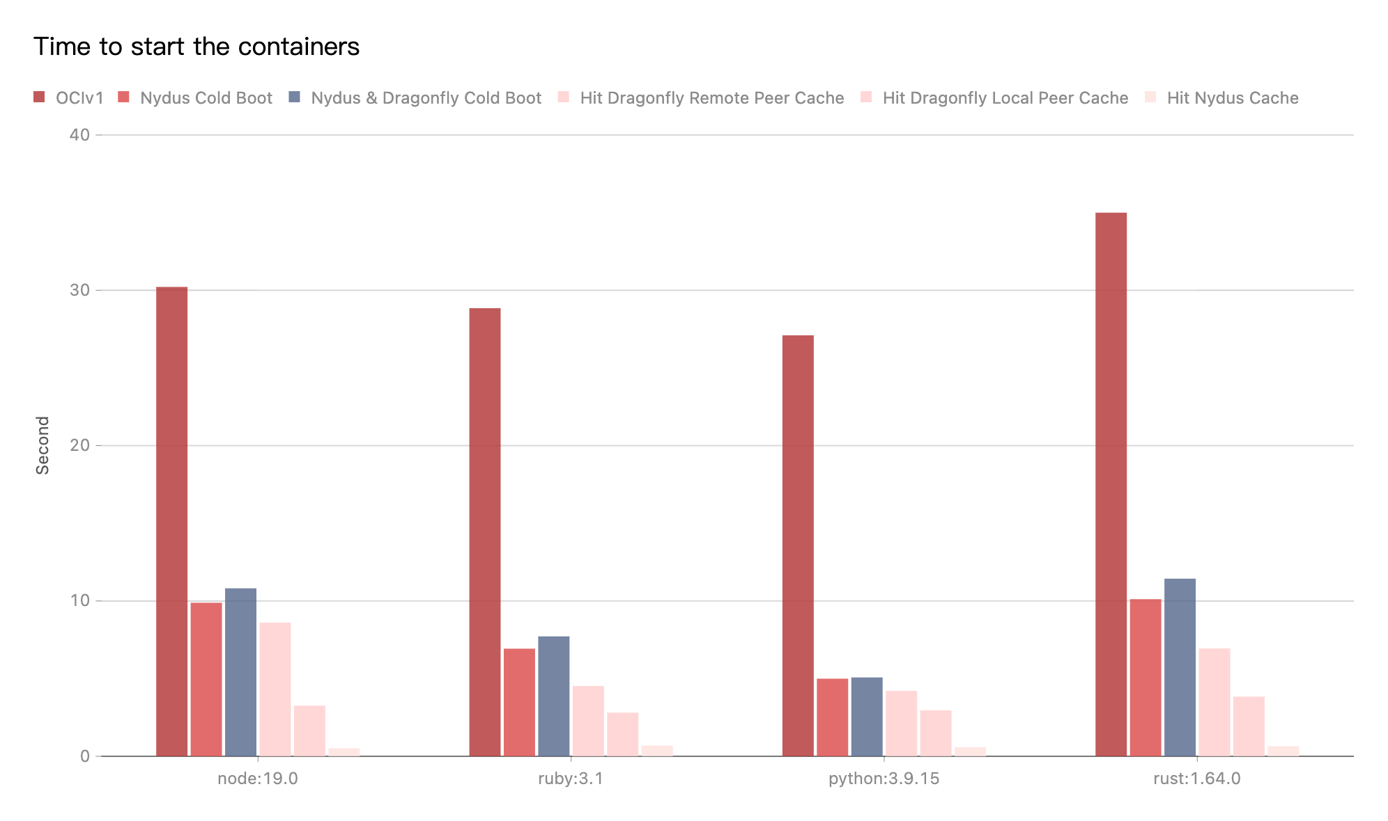
Performance Testing
Background:
Test the performance of single-machine image download after the integration of nydus mirror mode and dragonfly P2P. Test running version commands using images in different languages. For example, the startup command used to run a python image is python -V.
Scenarios:
OCIv1: Use containerd to pull image directly.
Nydus Cold Boot: Use containerd to pull image via nydus-snapshotter and doesn't hit any cache.
Nydus & Dragonfly Cold Boot: Use containerd to pull image via nydus-snapshotter. Transfer the traffic to dragonfly P2P based on nydus mirror mode and no cache hits.
Hit Dragonfly Remote Peer Cache: Use containerd to pull image via nydus-snapshotter. Transfer the traffic to dragonfly P2P based on nydus mirror mode and hit the remote peer cache.
Hit Dragonfly Local Peer Cache: Use containerd to pull image via nydus-snapshotter. Transfer the traffic to dragonfly P2P based on nydus mirror mode and hit the local peer cache.
Hit Nydus Cache: Use containerd to pull image via nydus-snapshotter. Transfer the traffic to dragonfly P2P based on nydus mirror mode and hit the nydus local cache.

Slide 11
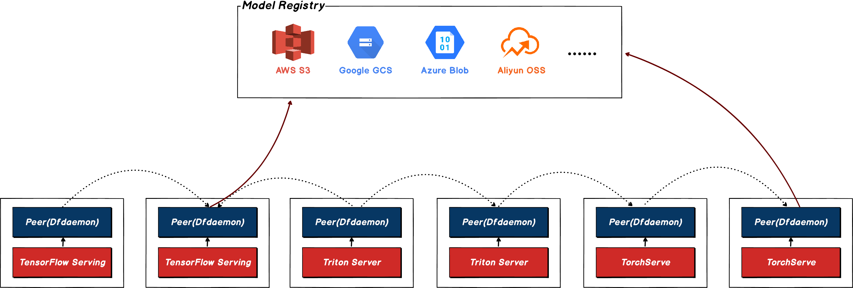
Machine Learning Model
P2P-based Downloading Models

Slide 12

Product Introduction
Container Registry, CR
CR is a product of ByteDance’s Cloud Service Volcano Engine, which provides secure and highly available container image hosting services to facilitate users to manage the entire lifecycle of container images.

Slide 13

Product Introduction
Volcengine Kubernetes Engine, VKE
VKE provides high-performance Kubernetes container cluster management services centered on containers through deep integration of next-generation cloud-native technologies, helping users quickly build containerized applications.

Slide 14
Product Introduction
Volcengine Container Instance, VCI
VCI is a serverless and containerized computing service. Currently, VCI can seamlessly integrate the container service VKE to provide Kubernetes orchestration capabilities.
With VCI, users can focus on building the application itself without purchasing and managing infrastructure such as underlying cloud servers, and only pay for the resources consumed by the actual running of the container.

Slide 15
Best Practice in Volcengine
Background: Why we need P2P
1. Bandwidth limit
2. QPS limit
Notes:
In a VKE K8S cluster, the number of clients is increasing.The image used by application may reach GB level.
If a image is Nydus format, the number of requests will increase by an order of magnitude.

Slide 16
P2P project
Dragonfly VS Kraken
 | Dragonfly | Kraken
high availability | Scheduler HA by hashring | Tracker HA by hashring
containerd support | yes | yes
HTTPS artifact registry support | yes | yes
community active | yes | no
users | more | less
production available | yes | yes
Nydus compitable | yes | no
architectural complexity | less | more
Dragonfly is a better option.

Slide 17
Proposal
Dragonfly/Nydus in VKE/VCI
1. Dragonfly deployed in VKE
2. Dragonfly Served for VCI
3. Dragonfly Served for Nydus

Slide 18
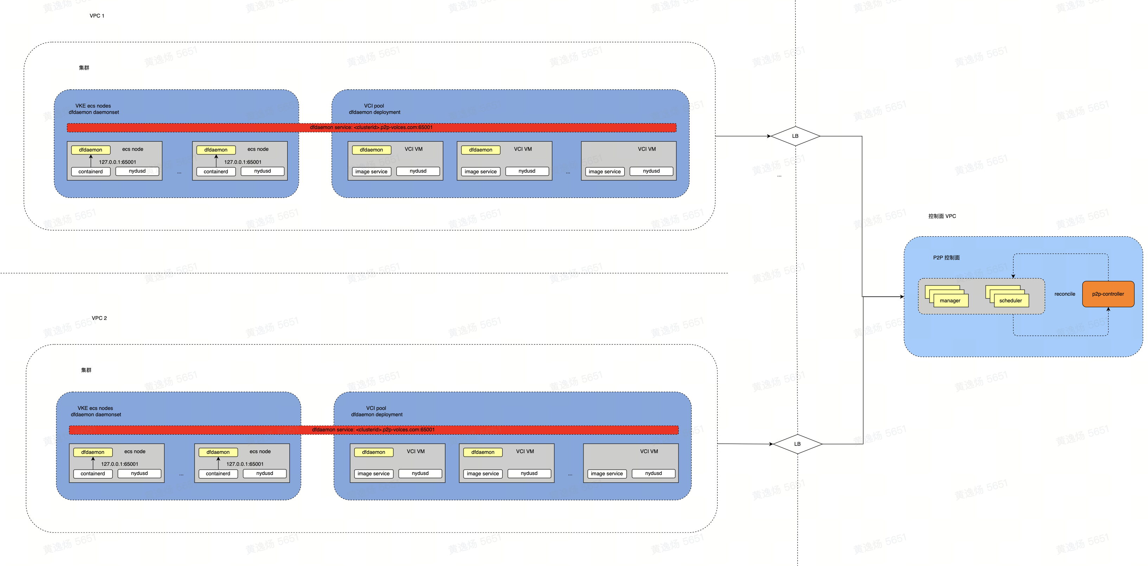
Architecture

Slide 19
Benchmark Data
Environment
CR：bandwith 10Gbit/s
ECS: 4C8G，with local ssd, bandwith 6Gbit/s
Image
Nginx(500M)
TensorFlow(3G)
Version
Dragonfly v2.0.8
Quota
Dfdaemon: Limit 2C6G
Scheduler: 2 Replicas，Request 1C2G，Limit 4C8G
Manager: 2 Replicas，Request 1C2G，Limit 4C8G

Slide 20
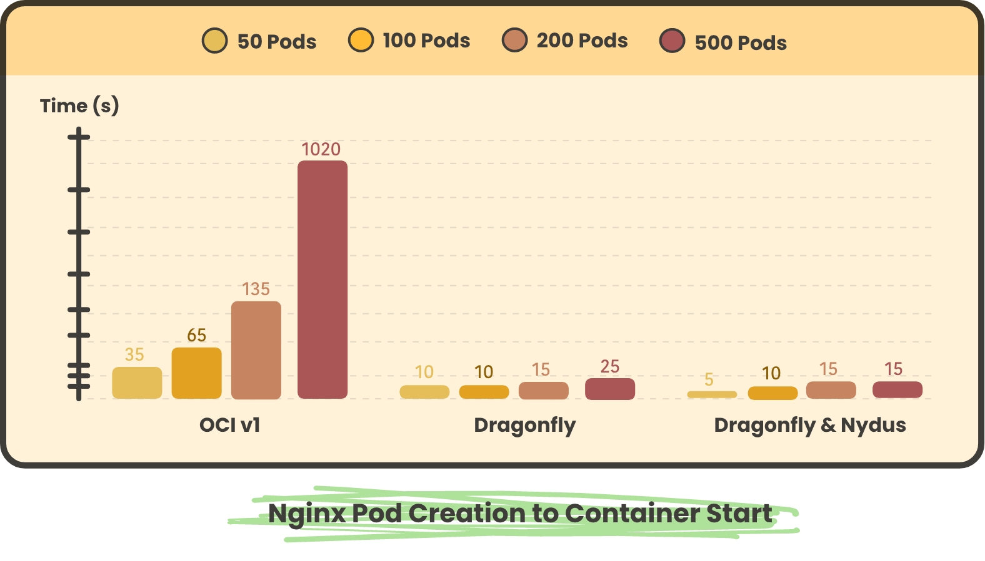
Benchmark Data

Slide 21
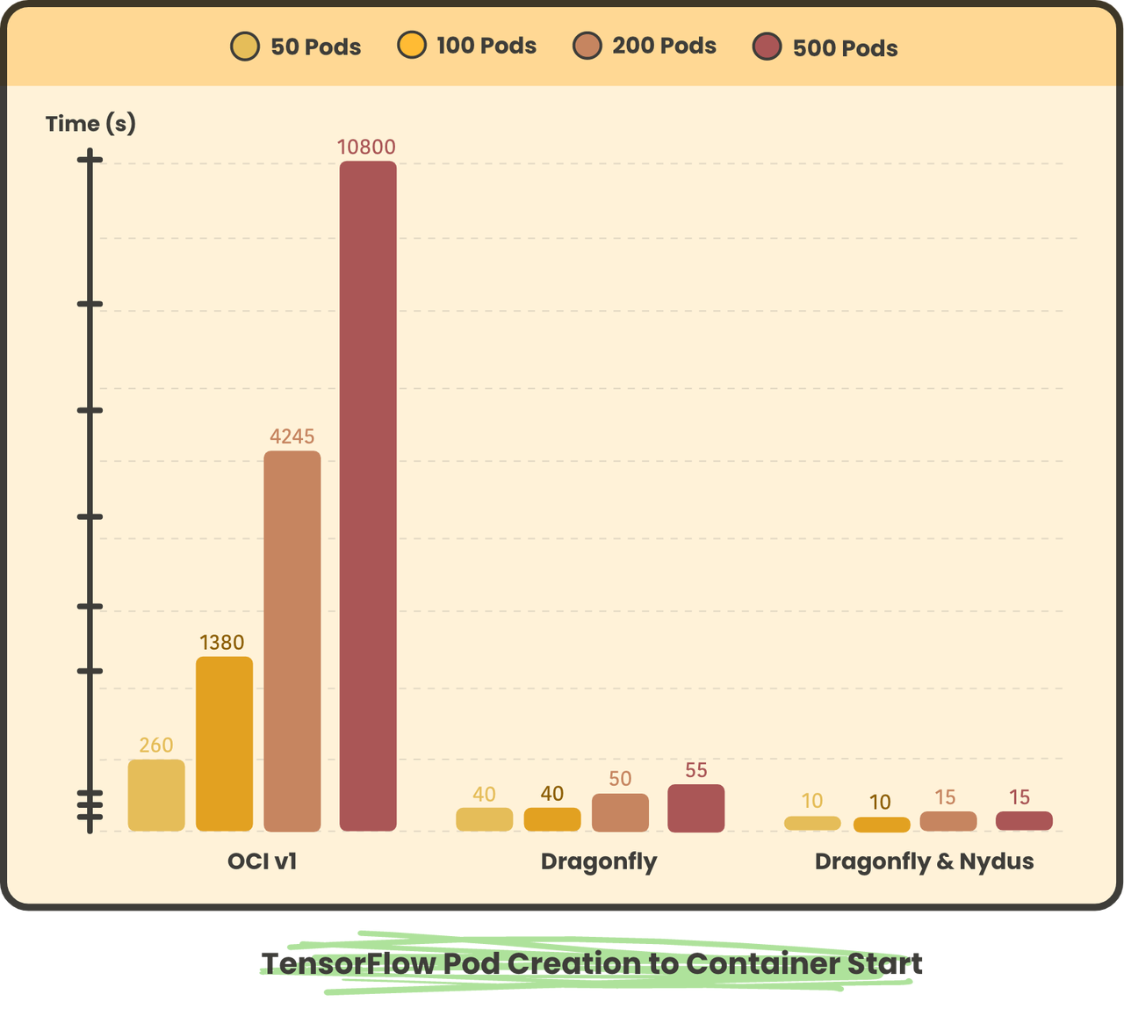
Benchmark Data

Slide 22
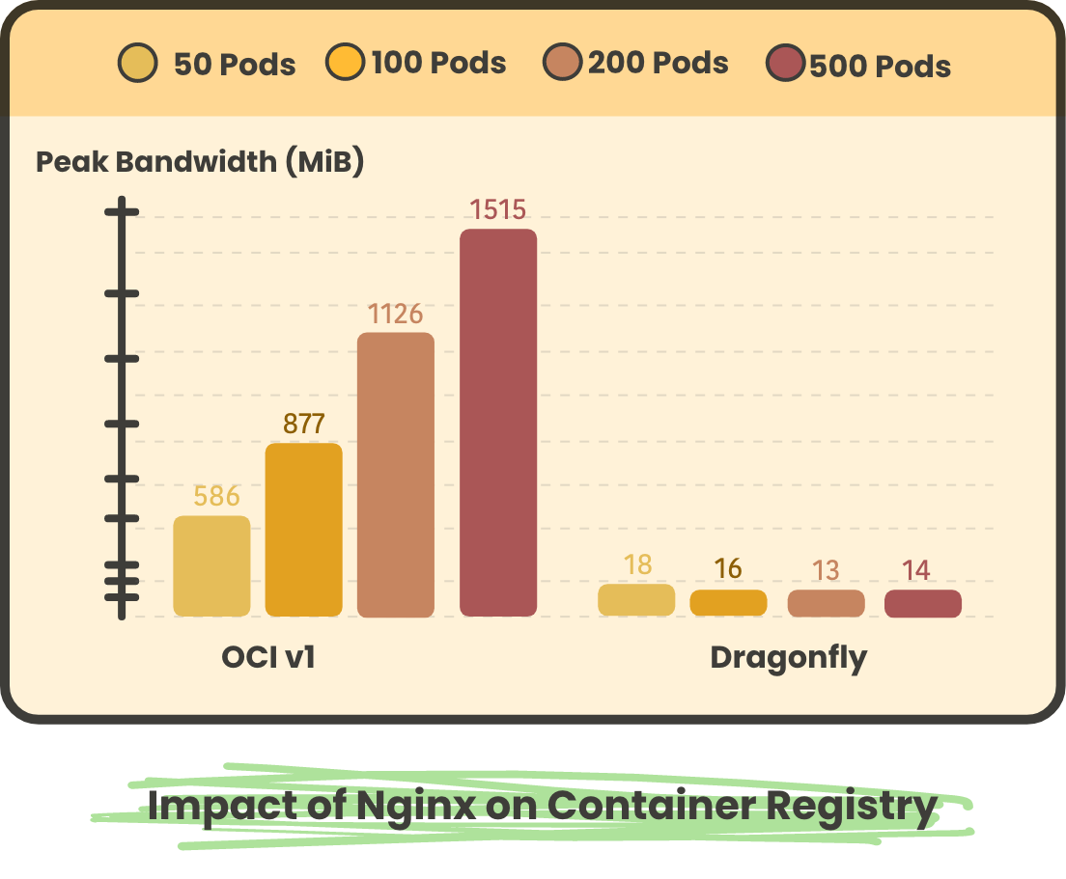
Benchmark Data

Slide 23
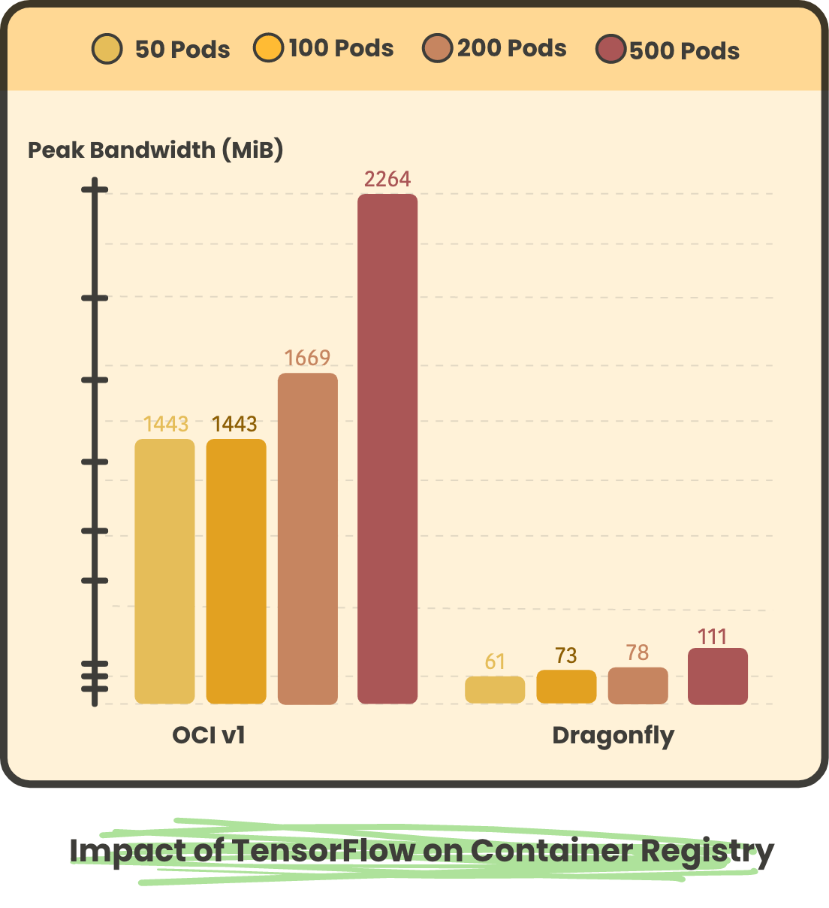
Benchmark Data

Slide 24
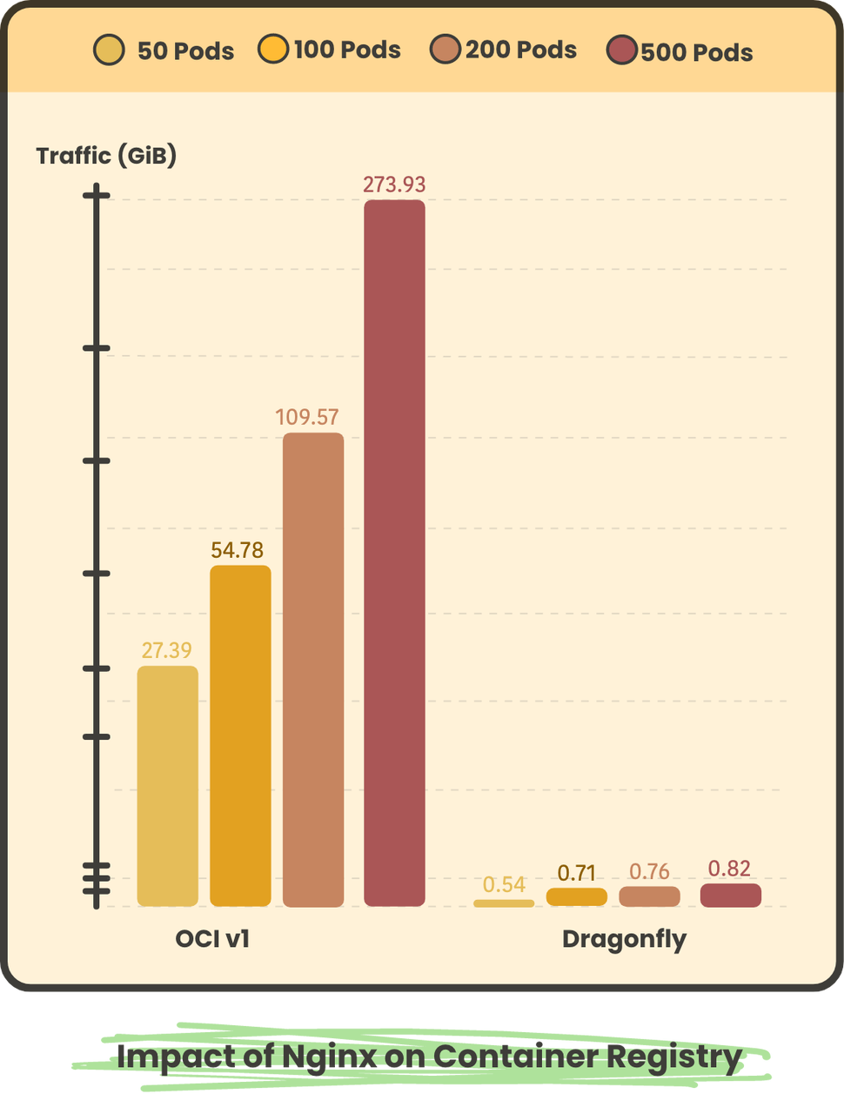
Benchmark Data

Slide 25
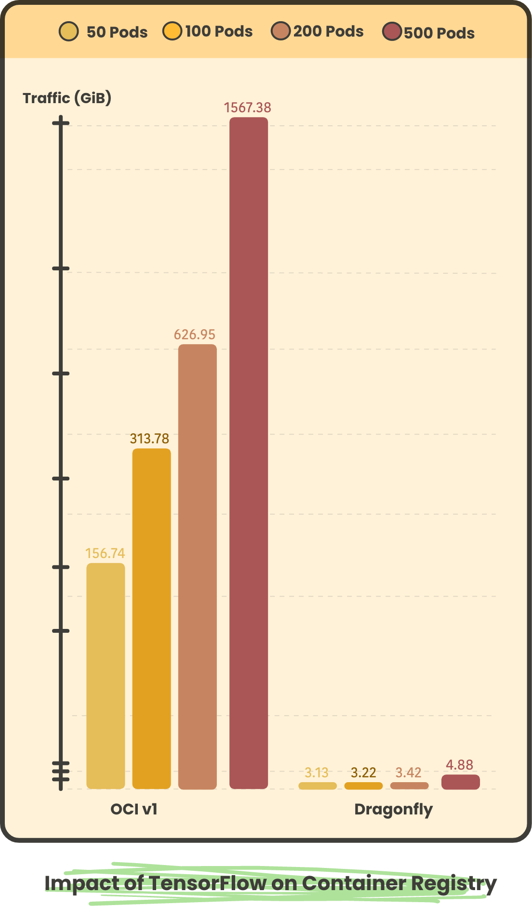
Benchmark Data

Slide 26






THANK YOU!
Dragonfly Website
Dragonfly Github
Dragonfly Twitter
Dragonfly Slack
Nydus Website
Nydus Github
Nydus Slack

